Slide 1
Coursera Capstone Project ‘Battle of Neighborhoods’
Pierre Wuethrich

Slide 2
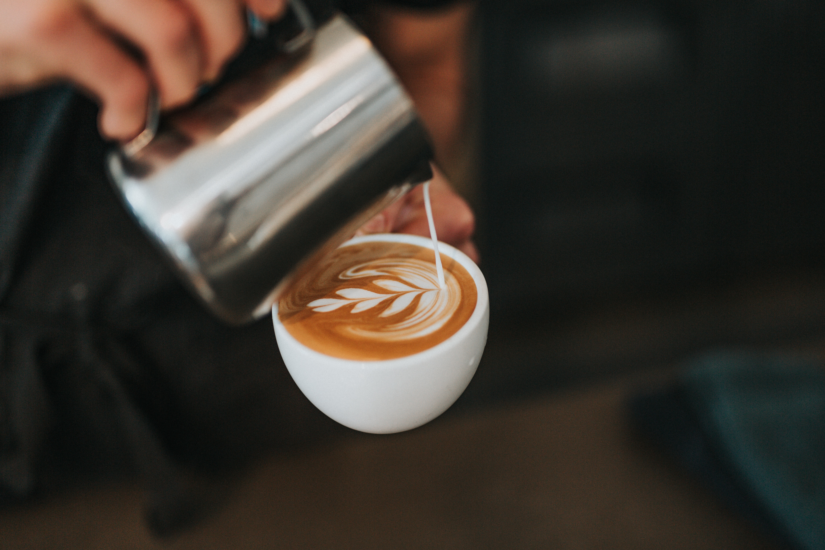
Introduction
Let’s assume that we have a client (our stakeholder) who wishes to open a new coffee shop in Tokyo. Our client is interested in knowing what types of coffee shops exist and how spatially distributed they are.
Our objective of this study is to analyze the coffee shop venues in Tokyo using the Foursquare API and trying to cluster the neighborhoods based on the obtained data
Photo by Tyler Nix on Unsplash

Slide 3
Data
The used data came from
Wikipedia (for getting the major wards/districts)
Foursquare API

Slide 4
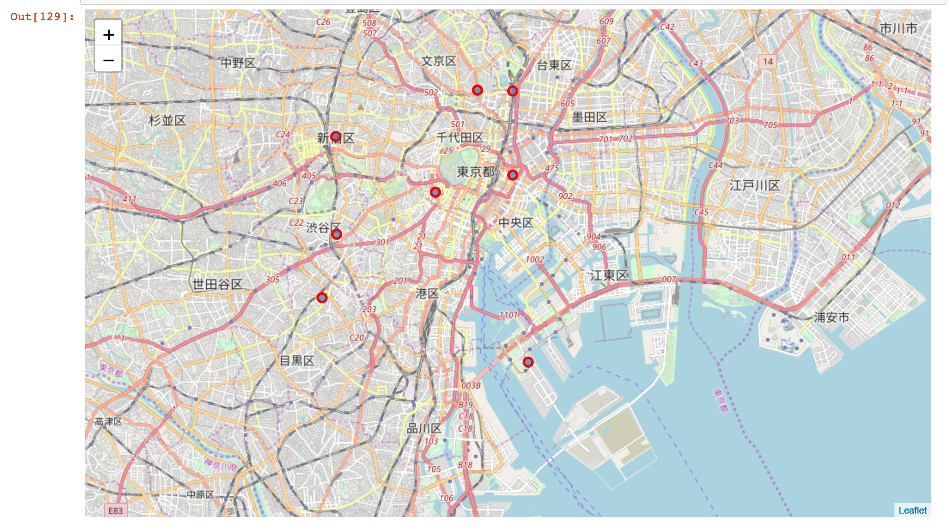
Considered districts
Tokyo has 23 wards in total, too many to be analyzed. That is why we restricted the wards of interest to be the 8 ones shown on the map below:
(FYI) Considered wards are: Shibuya, Shinkuku, Meguro, Taito, Bunkyo, Chuo, Chiyoda and Minato. For each ward, we considered the biggest district to extract the coordinates.

Slide 5
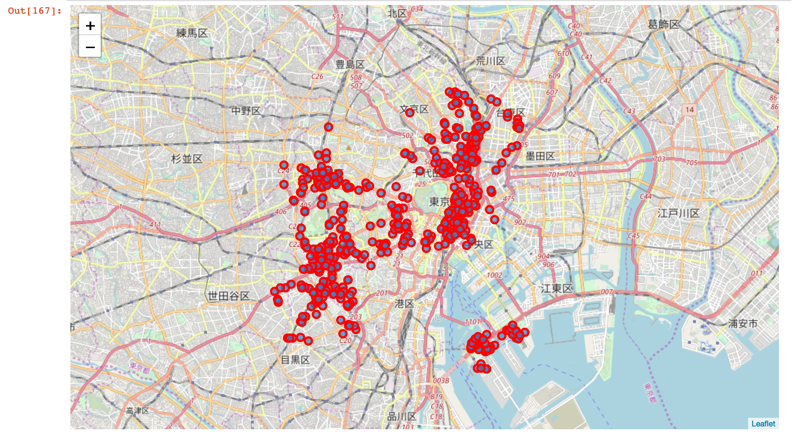
Adding the coffee shop venues
We can already distinguish that one group of venues (bottom right, Odaiba), is spatially further away than the rest of the venues.

Slide 6
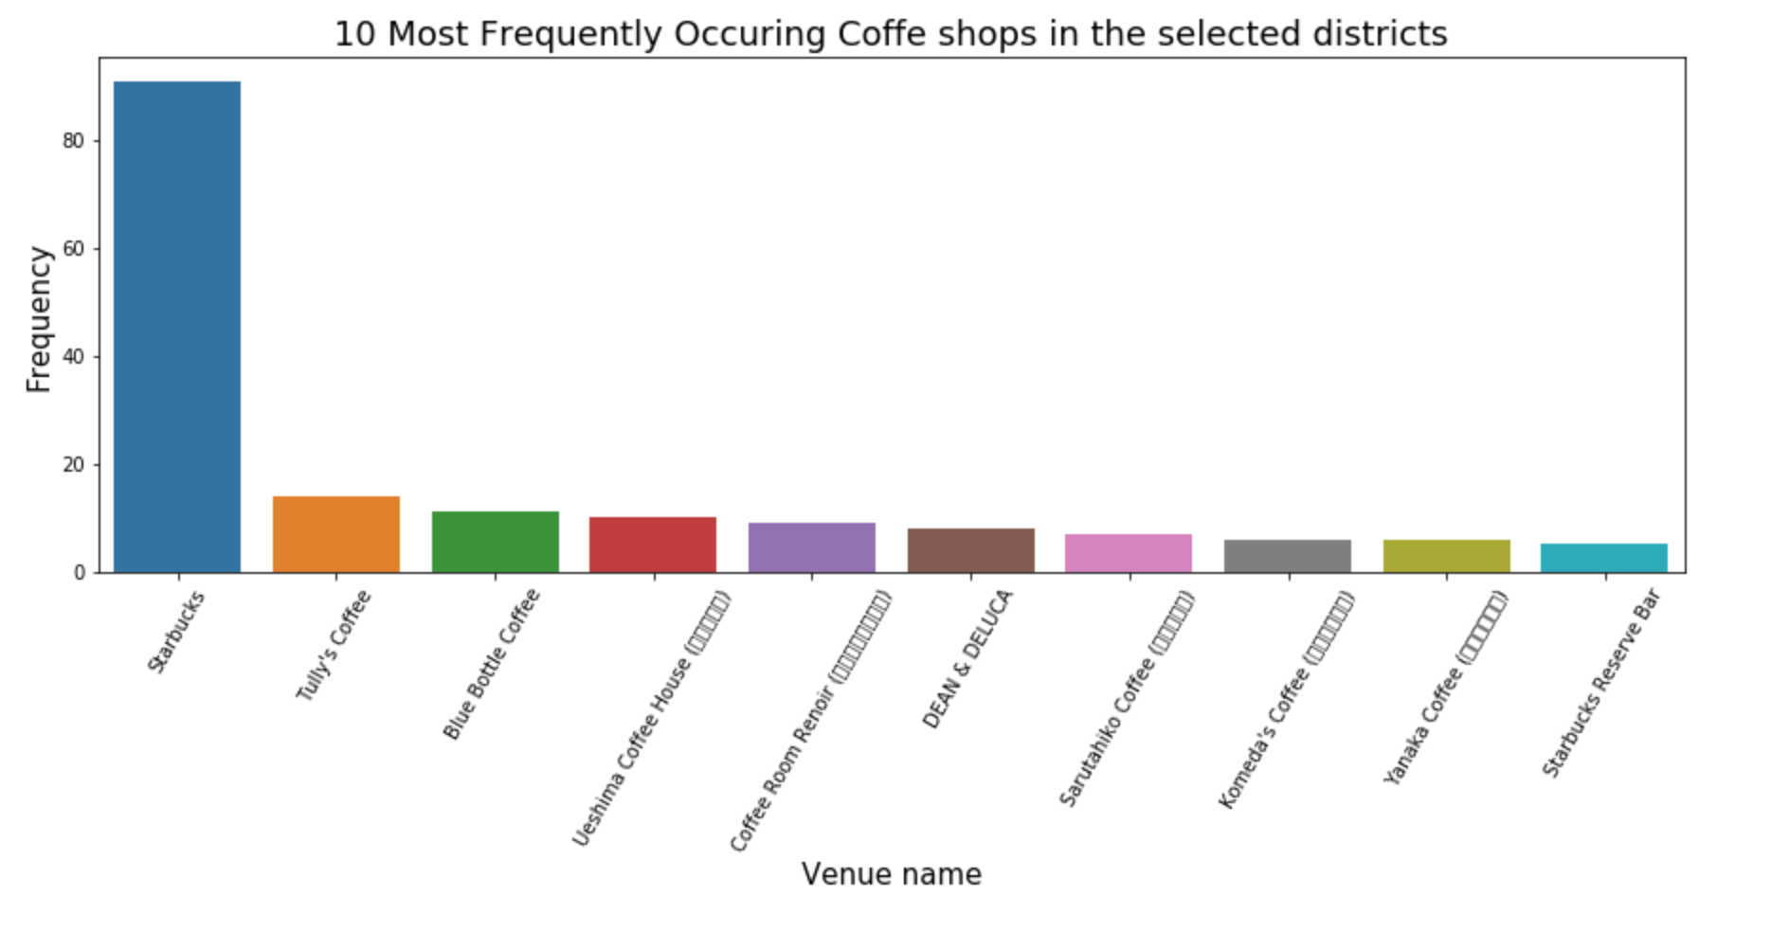
Frequency analysis
One brand clearly dominates the coffee shop market in Tokyo: Starbucks (91/758 venues).
Another interesting insight is that about 70% of all coffee shops are unique brands, not chains!

Slide 7
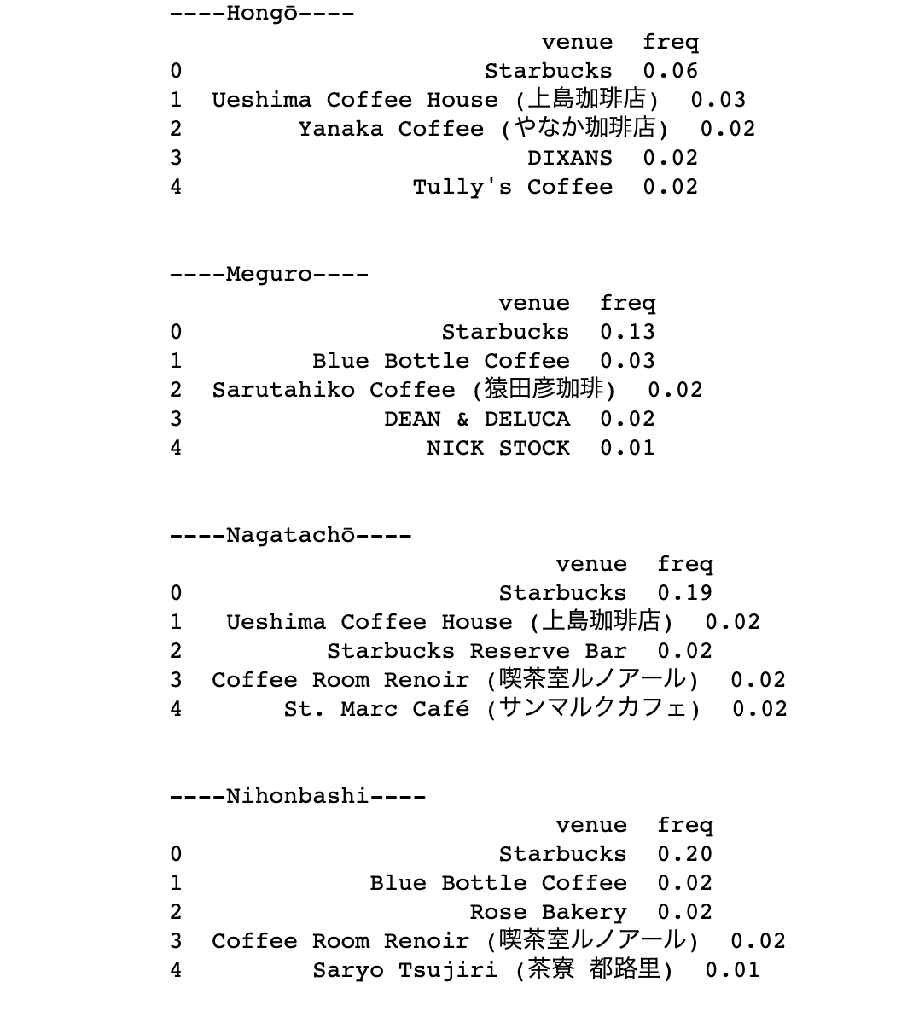
Frequency depending on location
Unsurprisingly, Starbucks is the most frequent venue in each single major district
Other reoccurring venues are: Blue Bottle Coffee, Ueshima Coffee House, Dean&Deluca, Tully’s Coffy, etc..

Slide 8
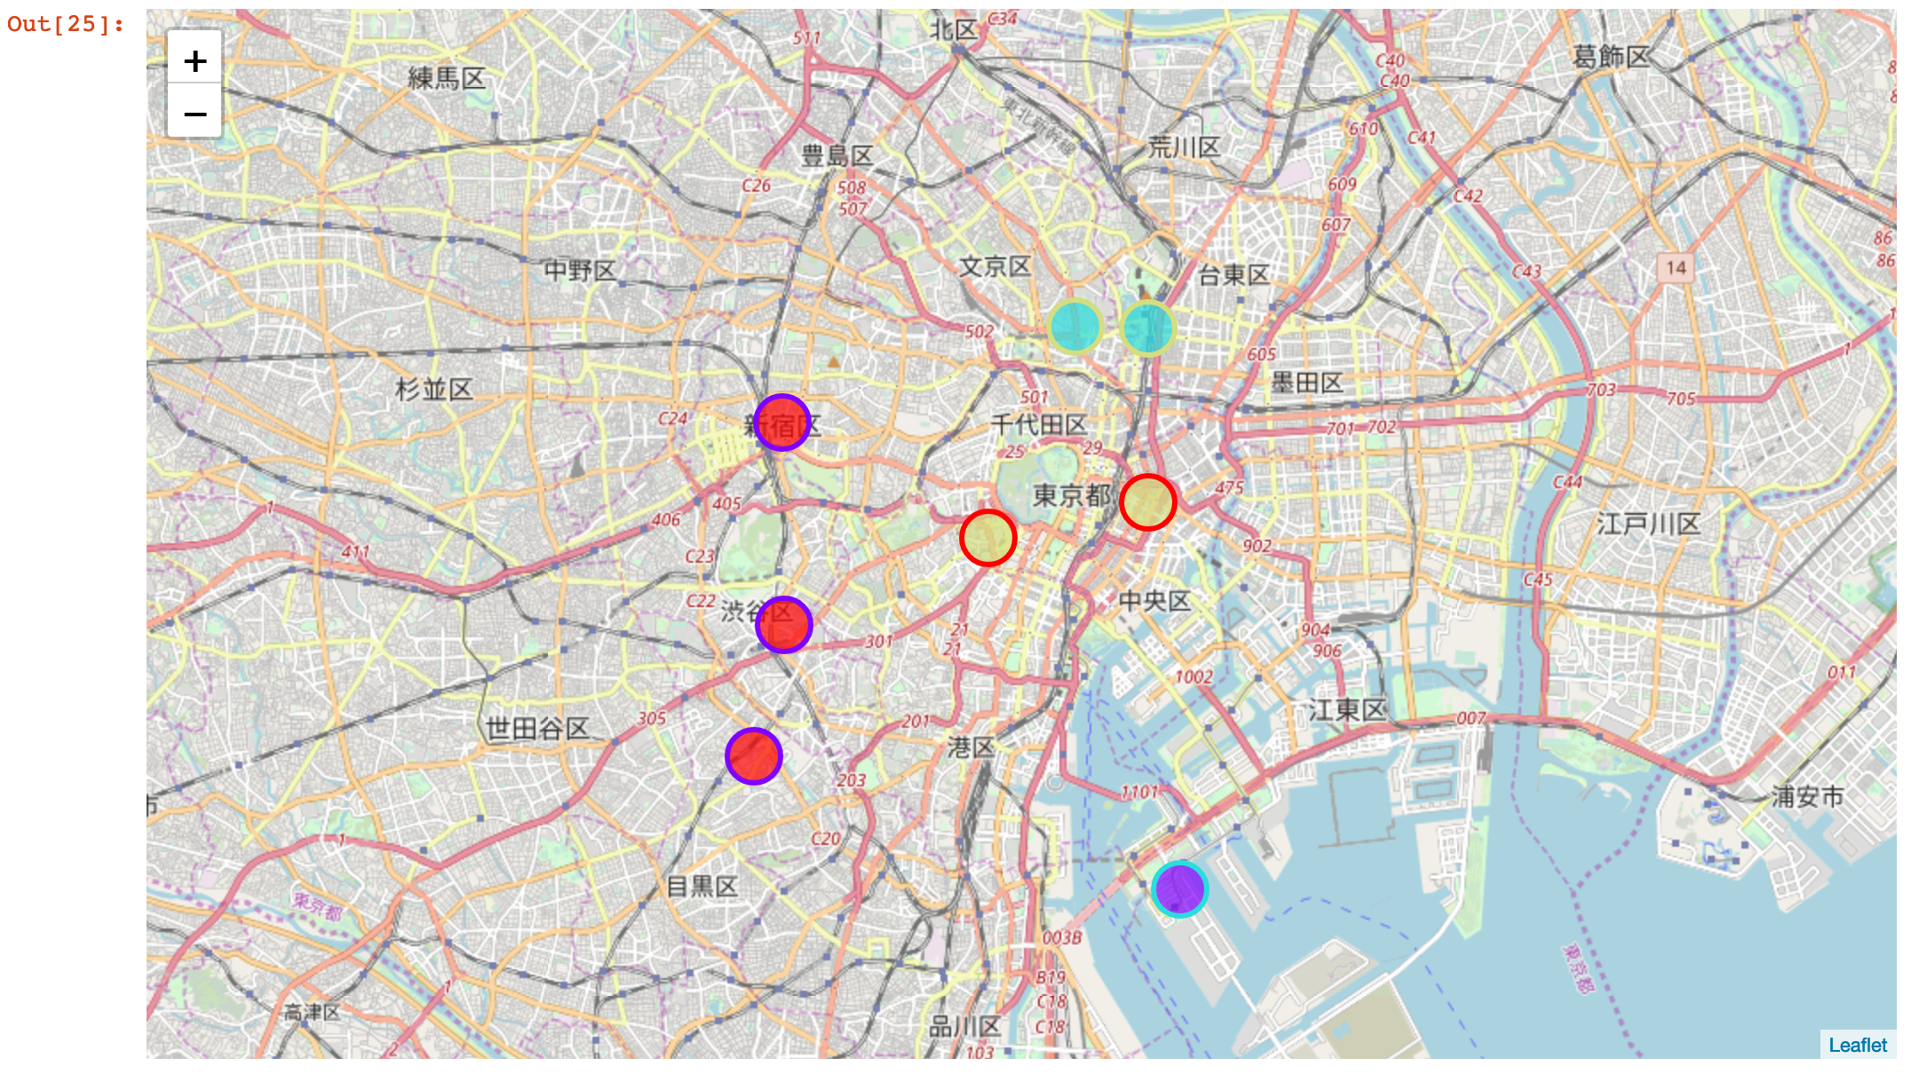
Clustering the neighborhoods according to their coffee shops (N=4)
Clustering the districts with respect to coffee shop venue frequencies shows us that districts near of each other also share a similar venue distribution. This is important insight if we want to open a new coffee shop.

Slide 9
Conclusion
results can be understood as a first step of evaluating the potential of opening a new coffee shop venue
We identified one major player (Starbucks)
Most coffee shop brands are unique, chain stores (brands with more than two stores) being the minority

Slide 10
Remarks
Completeness of the Foursquare API data?
e.g.: From own experience, Dotour Coffee has more shops than found by the API
It seems that the Foursquare API strongly relies on users and business owners to create entries into the database.
The drawback of this is that not all existing venues are in the database, distorting the true venue numbers and distribution, therefore diminishing the validity of any drawn insight.
We should be careful with the obtained data and make sure we understand the implicit biases of the data at hand.

